Slide 1
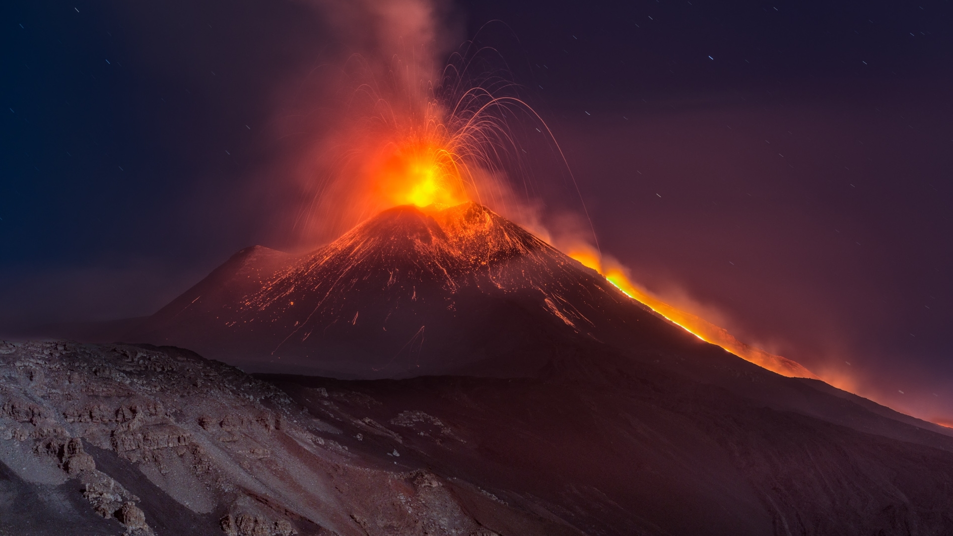
A Risk Analysis for the Etna Region Using Free and Open Source GIS
Johannes Nützel, Sebastian Ulmeanu, Tim Waibel

Slide 2
Content
adf
A Risk Analysis for the Etna Region Using Free and Open Source GIS

Slide 3
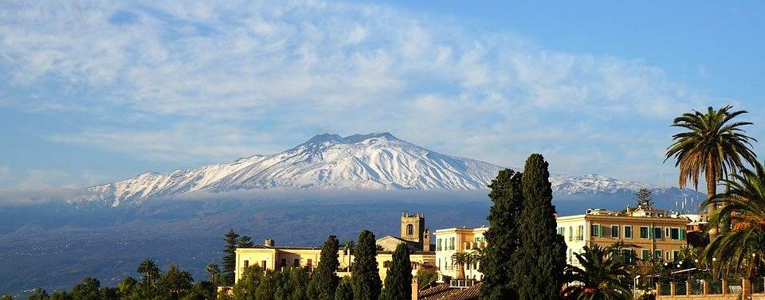
Mt. Etna and the surroundings
Fig.1 Mt. Etna (Pixabay 2020)
Some kind of text…
Notes:
Facts
History
Current status
Area

Slide 4
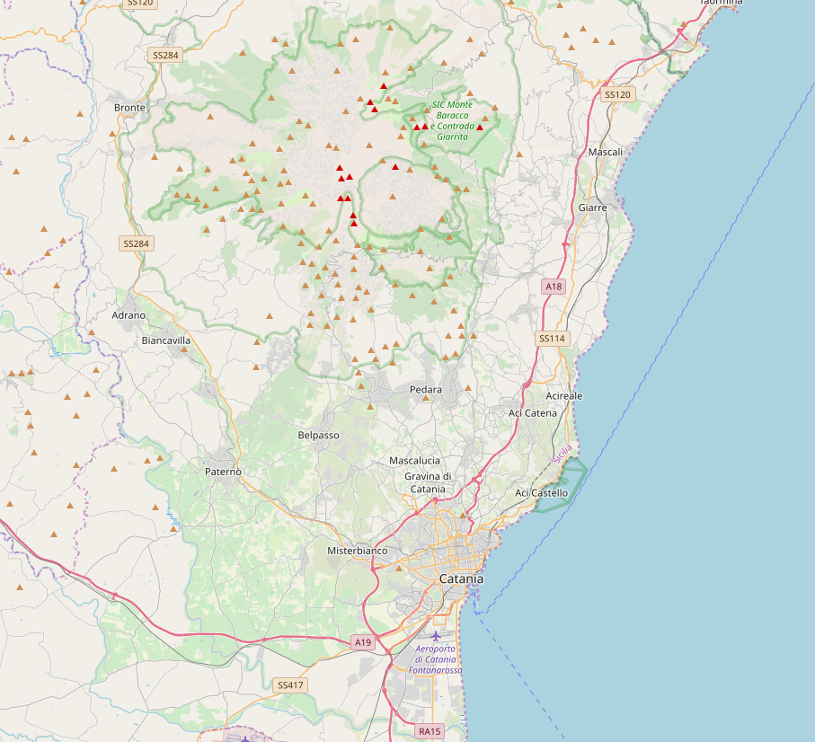
Fig.2 Surroundings of Mt. Etna (OpenStreetMap2020)
Some kind of text…

Slide 5

Motivation
Can we do it without professional software?
Can it be done without a numerical model?
A Risk Analysis for the Etna Region Using Free and Open Source GIS
Notes:
Why
How - workflow
What - results

Slide 6
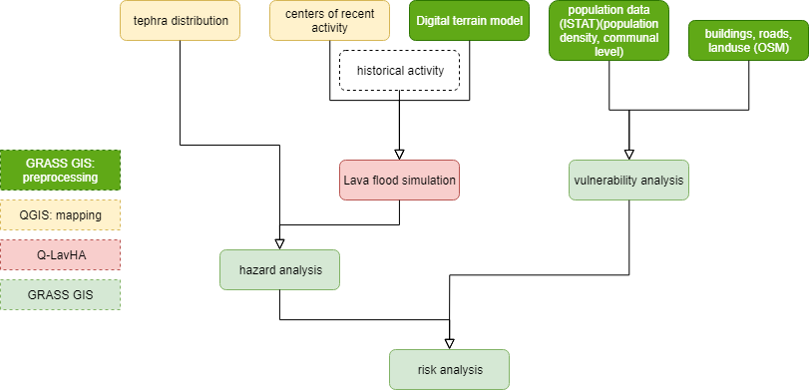
Workflow
A Risk Analysis for the Etna Region Using Free and Open Source GIS
Notes:
Why
How - workflow
What - results

Slide 7
Data
Information about hazards:
DTM and vent positions for lava flood simulation
Information about vulnerability
Population data
Administrative areas
Buildings
Landuse data
Street maps
A Risk Analysis for the Etna Region Using Free and Open Source GIS
Notes:
Population data: ISTAT = governmental data from census 2011 – can be downloaded e.g. just for Sicily and contains data for population, density sorted by postal codes
DTM from opendataportal (resolution 20m) as geotiff

Slide 8
Tools
Overpass Turbo for data collection
GRASS GIS for vulnerability analysis
QGIS for mapping
Q-LavHA for lava flood simulation
A Risk Analysis for the Etna Region Using Free and Open Source GIS
Notes:
GRASS GIS: Import, clip, rasterize, map calculation for vulnerability; v.db.droprow, dropcolumn (database operations) for preprocessing of population data and merging with geographical data (administrative regions)

Slide 9
Workflow
A Risk Analysis for the Etna Region Using Free and Open Source GIS

Slide 10
Vulnerability analysis
Building density
Number of buildings per 100x100m
Landuse
Different landuse purposes reclassified
Population density
Density of population per district
Road density
„Roadpoints“ of relevant roads per 100x100m
High vulnerability
Low vulnerability
A Risk Analysis for the Etna Region Using Free and Open Source GIS

Slide 11
Vulnerability analysis
A Risk Analysis for the Etna Region Using Free and Open Source GIS

Slide 12
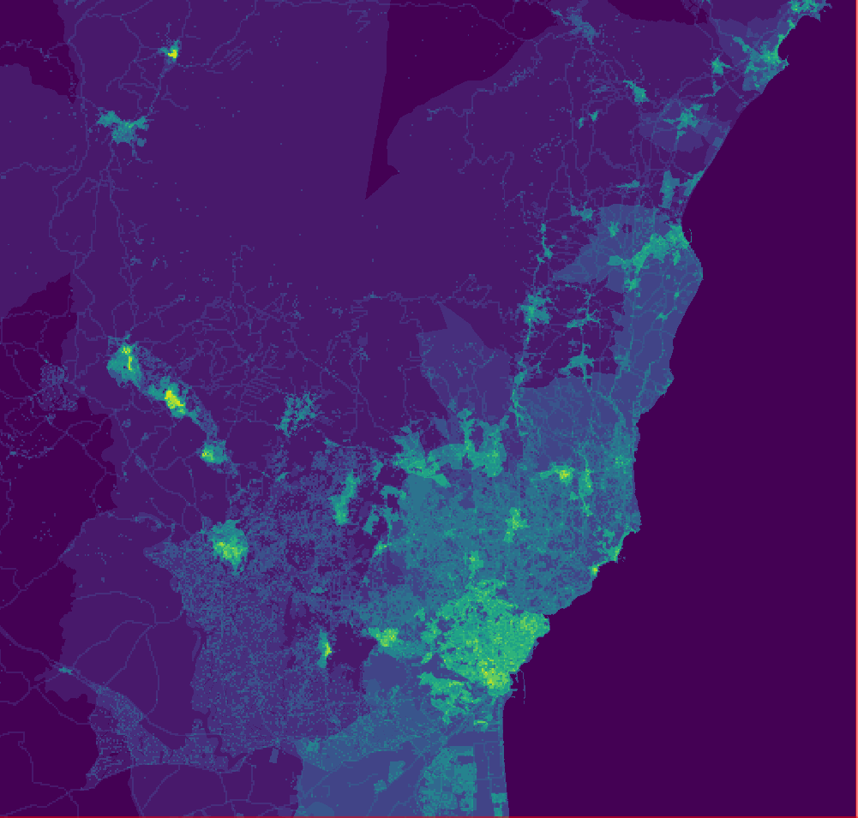
High vulnerability
Low vulnerability
Some kind of text…

Slide 13
Workflow
A Risk Analysis for the Etna Region Using Free and Open Source GIS

Slide 14
Q-LavHA
XXX
A Risk Analysis for the Etna Region Using Free and Open Source GIS

Slide 15
Workflow
A Risk Analysis for the Etna Region Using Free and Open Source GIS

Slide 16
Current Results
XXX
A Risk Analysis for the Etna Region Using Free and Open Source GIS

Slide 17
What‘s next?
Merging of vulnerability and hazard analysis
Replacing the 20m DTM model by 2m DTM model
Optimization of lava flood simulation
A Risk Analysis for the Etna Region Using Free and Open Source GIS

Slide 18
Resources
XXX
A Risk Analysis for the Etna Region Using Free and Open Source GIS

